Slide 1
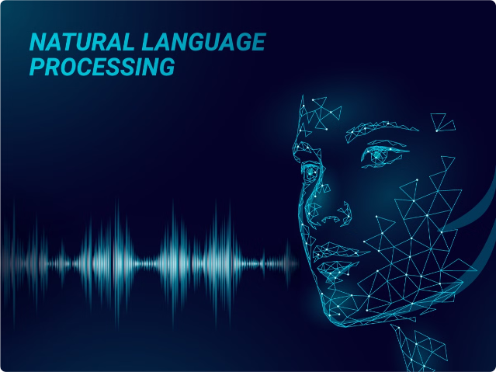

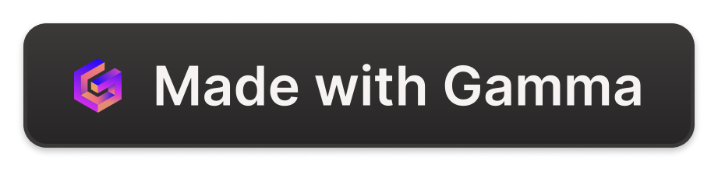
Introduction to LangChain and RAG Pipeline
LangChain is a powerful open-source framework that simplifies the development of large language model applications. The Retrieval Augmented Generation (RAG) model combines language models with information retrieval to enhance the generation capabilities.
by Jai ganesh - jai92ganesh Suresh

Slide 2
Technical Architecture Overview
LangChain Components
RAG Model
Integration
LangChain provides modular components like Agents, Chains, and Prompts to build robust NLP applications.
The RAG model integrates a language model with a retriever to generate context-aware and knowledge-infused responses.
LangChain seamlessly integrates with RAG to enable end-to-end retrieval-augmented generation workflows.

Slide 3

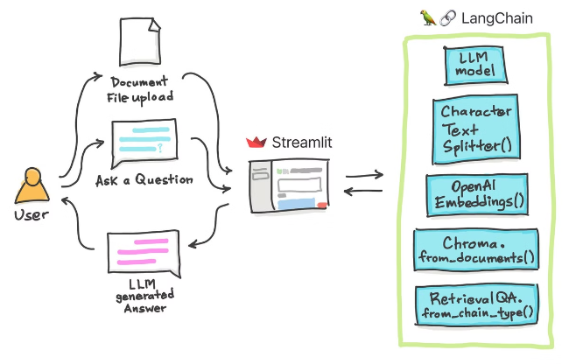
LangChain Components and Functionality
1
Agents
Autonomous AI agents that can perceive their environment, reason, and take actions.
2
Chains
Sequences of steps that can be executed to complete a task.
3
Prompts
Templates that guide language models to generate desired outputs.
4
Memory
Mechanisms to store and retrieve relevant information during a conversation.

Slide 4

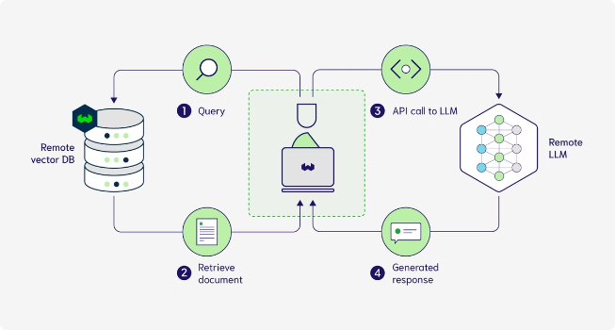
RAG Model: Retrieval Augmented Generation
1
Retrieval
The RAG model retrieves relevant information from a knowledge base to supplement the language model's input.
2
Fusion
The retrieved information is seamlessly integrated with the language model's output to generate more contextual and informed responses.
3
Generation
The combined model generates highly relevant and coherent outputs based on the original input and the retrieved knowledge.

Slide 5

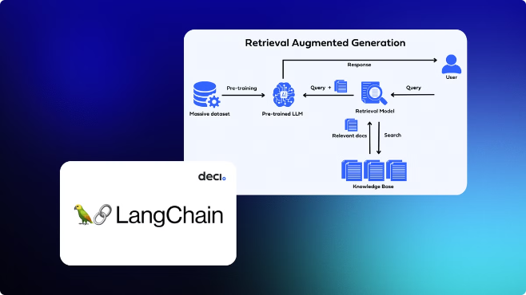
Integrating LangChain and RAG Models
Seamless Integration
LangChain provides built-in support for using RAG models, enabling easy integration and deployment.
Flexible Configuration
Users can customize the RAG model, retriever, and other components to fit their specific needs.
End-to-End Pipelines
LangChain allows you to create complete, end-to-end retrieval-augmented generation pipelines for various applications.
Scalability
The modular design of LangChain and RAG enables easy scaling to handle large-scale deployments.

Slide 6

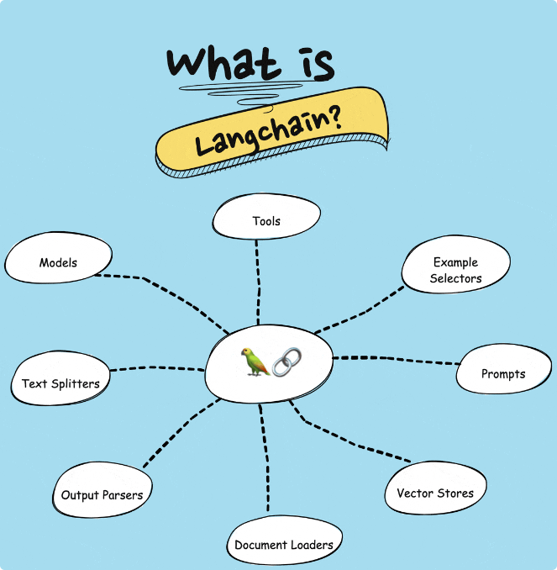



Benefits of Using LangChain and RAG
Knowledge-Powered
The RAG model enhances language model capabilities with external knowledge, leading to more informative and contextual outputs.
Productivity
LangChain's modular design and built-in components accelerate the development of complex NLP applications.
Scalability
The architecture of LangChain and RAG allows for efficient scaling to handle large-scale deployments.
Flexibility
LangChain and RAG provide numerous customization options to fit diverse use cases and requirements.

Slide 7

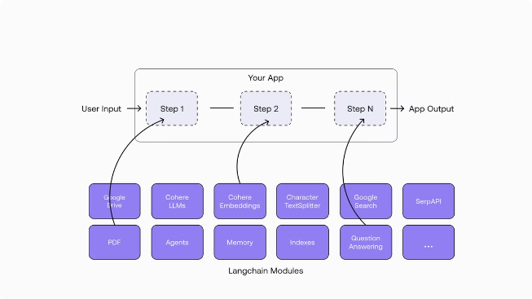
Comparison: LangChain vs. Other Frameworks
Feature
LangChain
Other Frameworks
Retrieval Augmentation
Seamless integration with RAG model
Limited or no built-in support
Modularity
Highly modular design with reusable components
Monolithic architecture with less flexibility
Scalability
Designed for large-scale deployments
May struggle with high-volume use cases
Customization
Extensive configuration options
More rigid and less customizable

Slide 8

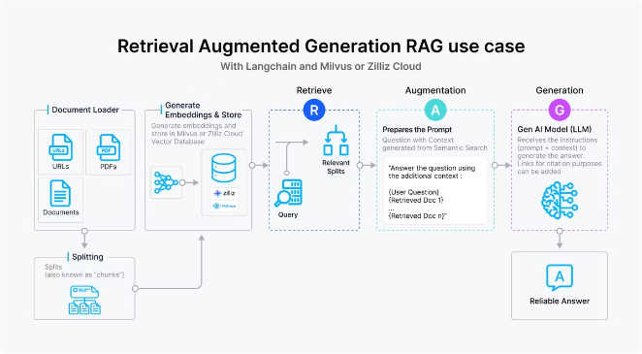



Real-World Applications and Use Cases
Question Answering
LangChain and RAG enable the development of intelligent question-answering systems that can retrieve and synthesize relevant information.
Conversational AI
The combination of LangChain and RAG allows for the creation of contextual and knowledge-driven chatbots and virtual assistants.
Content Generation
LangChain and RAG can be used to generate high-quality content, such as articles, reports, and summaries, by leveraging external knowledge.
Intelligent Automation
The modular design of LangChain enables the development of automated workflows that combine language understanding, retrieval, and generation.

Slide 9
Deployment and Scalability Considerations
Containerization
Distributed Computing
Cloud Integration
LangChain and RAG models can be packaged into Docker containers for easy deployment and scaling.
The modular architecture of LangChain allows for efficient distribution of workloads across multiple machines or serverless functions.
LangChain and RAG models can be seamlessly integrated with cloud-based AI services for scalable and cost-effective deployments.

Slide 10
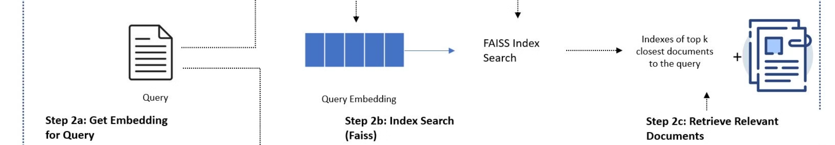
Conclusion and Future Developments
1
Continued Innovation
2
Expanding Capabilities
The LangChain and RAG frameworks are actively developed and maintained, with new features and improvements on the horizon.
As language models and retrieval techniques advance, the integration of LangChain and RAG will continue to enhance the capabilities of AI applications.
3
Broader Adoption
4
Collaboration and Ecosystem
The growing popularity of LangChain and RAG is expected to drive wider adoption in the AI and NLP communities.
The open-source nature of LangChain and RAG fosters a vibrant ecosystem of contributors and collaborators, further driving innovation.

